Slide 1
Linux device driver
Day 35 PPT
-SUBITHRA s

Slide 2
lseek
lseek is a system call in Unix and Unix-like operating systems that changes the current position (offset) of a file descriptor. Here’s a simplified explanation:
Purpose
lseek is used to move the file pointer to a specific location within an open file, allowing for random access (i.e., reading or writing at any position within the file).
off_t lseek(int fd, off_t offset, int whence);

Slide 3
lseek
Parameters
fd: The file descriptor of the file.
offset: The position to move the file pointer to.
whence: The reference point for the offset. It can be:
SEEK_SET: From the beginning of the file.
SEEK_CUR: From the current position.
SEEK_END: From the end of the file.
Return Value
On success: Returns the new offset.
On failure: Returns -1 and sets errno.
Use Cases
Move to the beginning of a file: lseek(fd, 0, SEEK_SET).
Skip ahead or back: lseek(fd, n, SEEK_CUR) (where n can be positive or negative).
Move to the end of a file: lseek(fd, 0, SEEK_END).

Slide 4
Kernel Credentials
The kernel uses a structure, often referred to as cred, to manage the credentials of a process. This structure includes several fields related to user IDs and group IDs, which help determine what permissions a process has when accessing system resources.
User IDs
User ID (UID): The unique identifier for a user on the system.

Slide 5
Kernel Credentials
Current User ID (cuid): This term isn't standard in Unix terminology, but if referenced, it typically means the real user ID (ruid) or the saved user ID (suid), depending on the context. More commonly, Unix-like systems use:
Real User ID (ruid): The UID of the user who created the process. It identifies the actual user who owns the process.
Saved User ID (suid): Used to save the previous effective UID when a process's effective UID is changed temporarily. It allows the process to switch back to the original effective UID.
Effective User ID (euid): The UID that the kernel uses to determine the permissions of a process for most operations, such as accessing files and making system calls. It can be different from the real UID, especially when executing setuid programs.

Slide 6
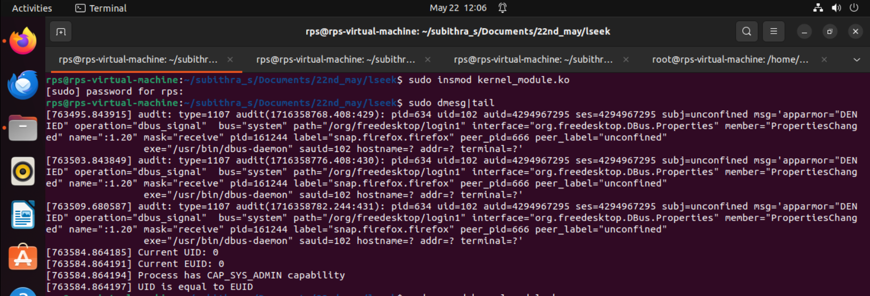
Kernel Credentials

Slide 7
Role of device-drivers
user space kernel space
Linux
operating system
kernel
standard
runtime
libraries
file
subsystem
networking
subsystem
character
device driver
network
device driver
application
program
hardware devices

Slide 8
Source-code layout
netframe.c
#include <linux/module.h>
#include <linux/etherdevice.h>
…
typedef struct {
/* driver’s private data */
} MY_DRIVERDATA;
char modname[ ] = “netframe”;
struct net_device *netdev;
my_open()
my_stop()
The network driver’s
“payload” functions
my_hard_start_xmit()
my_isr()
my_get_info()
Optional pseudo-file (for
debugging assistance)
The mandatory module-
administration functions
my_init
my_exit

Slide 9
Interactions with the kernel
module_init() calls ‘register_netdev()’
module_exit() calls ‘unregister_netdev()’
open() calls ‘netif_start_queue()’
stop() calls ‘netif_stop_queue()’
hard_start_xmit() calls ‘dev_kfree_skb()’
rx_handler() calls ‘dev_alloc_skb()’ and netif_rx()’

Slide 10
‘mynetdvr.c’
We can demonstrate the basic transmit and receive functionality of our network driver using a pair of ‘anchor’ machines
But we have to work around some slight amount of interference with the already-installed ‘e1000’ network-driver which is supporting our ability to do remote login via the ‘eth0’ device interface

Slide 11
Building Blocks
Nodes: PC, special-purpose hardware…
hosts
switches
Links: coax cable, optical fiber…
point-to-point
multiple access
(a)
(b)
■ ■ ■

Slide 12
Switched Networks
A network can be defined recursively as...
two or more nodes connected by a link, or
two or more networks connected by a node

Slide 13
Firewall configurations

Slide 14
Addressing and Routing
Address: byte-string that identifies a node
usually unique
Routing: process of forwarding messages to the destination node based on its address
Types of addresses
unicast: node-specific
broadcast: all nodes on the network
multicast: some subset of nodes on the network

Slide 15
Inter-Process Communication
Turn host-to-host connectivity into process-to-process communication.
Fill gap between what applications expect and what the underlying technology provides.

Slide 16
Multiplexing
Circuit switching: carry bit streams
original telephone network
Packet switching: store-and-forward messages
Internet

Slide 17
Statistical Multiplexing
On-demand time-division
Schedule link on a per-packet basis
Packets from different sources interleaved on link
Buffer packets that are contending for the link
Buffer (queue) overflow is called congestion
■ ■ ■

Slide 18
Conceptual layering of protocol software
Message sent
Message received
Layer n
Layer 2
Layer 1
Sender
Communication
Recipient
medium

Slide 19
Encapsulation as it is applied in layered protocols

Slide 20
ISO Architecture

Slide 21
OSI protocol summary
Layer
Description
Examples
Application
Protocols that are designed to meet the communication requirements of
HTTP,
FTP
,
SMTP,
specific applications, often defining the interface to a service.
CORBA IIOP
Presentation
Protocols at this level transmit data in a network representation that is
Secure Sockets
independent of the representations used in individual computers, which may
(
SSL),CORBA Data
differ. Encryption is also performed in this layer, if required.
Rep.
Session
At this level reliability and adaptation are performed, such as detection of
failures and automatic recovery.
Transport
This is the lowest level at which messages (rather than packets) are handled.
TCP,
UDP
Messages are addressed to communication ports attached to processes,
Protocols in this layer may be connection-oriented or connectionless.
Network
Transfers data packets between computers in a specific network. In a WAN
IP,
ATM virtual
or an internetwork this involves the generation of a route passing through
circuits
routers. In a single LAN no routing is required.
Data link
Responsible for transmission of packets between nodes that are directly
Ethernet MAC,
connected by a physical link. In a WAN transmission is between pairs of
ATM cell transfer,
routers or between routers and hosts. In a LAN it is between any pair of hosts.
PPP
Physical
The circuits and hardware that drive the network. It transmits sequences of
Ethernet base- band
binary data by analogue signalling, using amplitude or frequency modulation
signalling,
ISDN
of electrical signals (on cable circuits), light signals (on fibre optic circuits)
or other electromagnetic signals (on radio and microwave circuits).

Slide 22
TCP/IP layers
Message
Layers
Application
Messages (UDP) or Streams (TCP)
Transport
UDP or TCP packets
Internet
IP datagrams
Network interface
Network-specific frames
Underlying network

Slide 23
Encapsulation in a message transmitted via TCP over an Ethernet
Application message
TCP header
port
IP header
TCP
Ethernet header
IP
Ethernet frame

Slide 24
Protocol Multiplexing
Multiplexing and Demultiplexing (demux key)
Encapsulation (header/body)
Host
Host
Application
Application
Application
Application
program
program
program
program
Data
Data
RRP
RRP
RRP Data
RRP Data
HHP
HHP
HHP RRP Data

Slide 25
Scalable Networks
Switch
Connect links to form a larger network.
Connect switches to form a larger network.
forwards packets from input port to output port
port selected based on address in packet header
Advantages
store and forward
support large numbers of hosts

Slide 26
Datagram Switching
No connection setup phase
Sometimes called connectionless model
Each packet forwarded independently
Each switch maintains a forwarding (routing) table
Eg. Switch 1

Slide 27
Internetworking
Concatenation of Different Networks

Slide 28
IP Internet
Connecting Problem 1: Heterogeneity of Networks
Solution: Layered Protocol Stack (IP over …… )
Problem 2: Scalability in Routing and Addressing
Solution: Address Hierarchy

Slide 29
Simple Demultiplexor (UDP)
Unreliable and unordered datagram service
Adds multiplexing
No flow control or error control
no need for sender-side buffer)
Endpoints identified by ports
servers listens at well-known ports!
see /etc/services on Unix
Header format
Optional checksum
psuedo header (IP.src, IP.dsest, IP.proto, UDP.len) + UDP header + data

Slide 30
TCP Overview
Connection-oriented
Byte-stream
app writes bytes
TCP sends segments
app reads bytes
Full duplex
Flow control: keep sender from overrunning receiver
Congestion control: keep sender from overrunning network
Application process
Application process
Write
Read
bytes
bytes
TCP
TCP
Send buffer
Receive buffer
Segment
Segment
■ ■ ■
Segment
Transmit segments

Slide 31
THANK YOU

